Slide 1

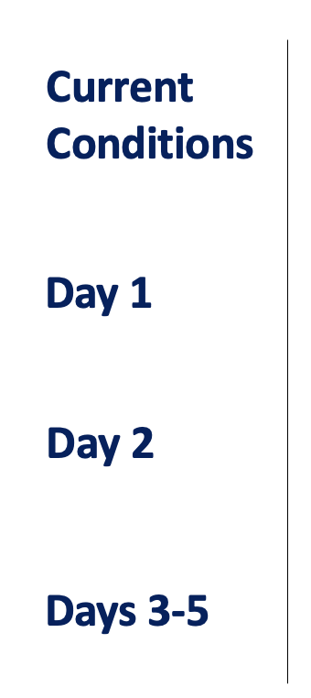
CPEX-CV Forecast
September 1, 2022
Lead name, Support name, Support Name, Support Name
XXX.
XXX.
XXX.
XXX.

Slide 2
Forecast Post-mortem for Yesterday
Dust and Aerosols (SAL):
AEWs:
Convection:

Slide 3
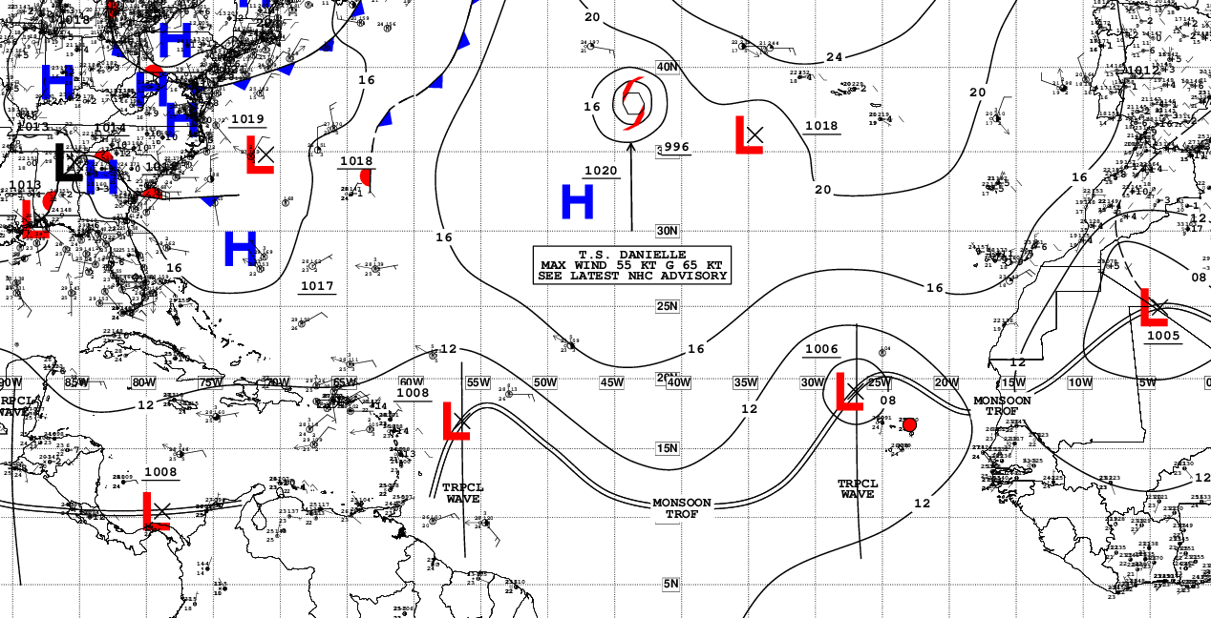
Current Conditions – Synoptic View
NHC Surface Analysis (XXZ)
…
…

Slide 4
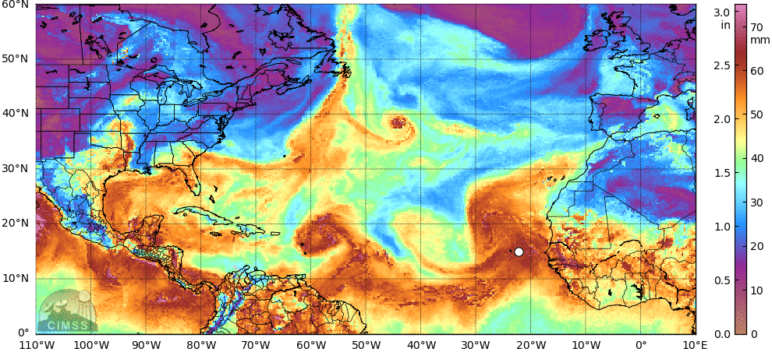
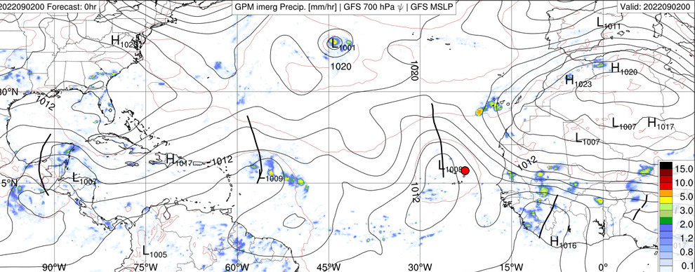
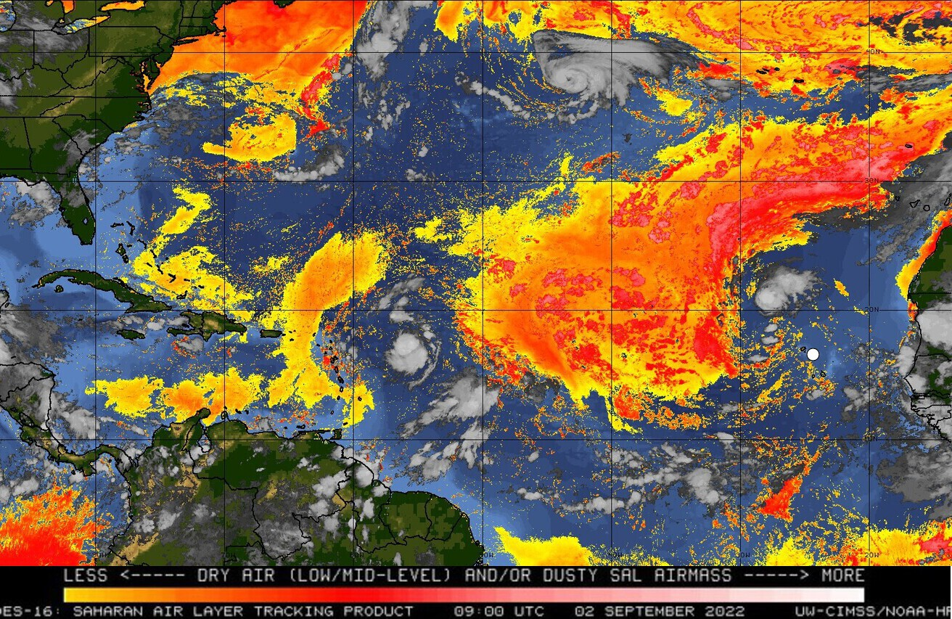
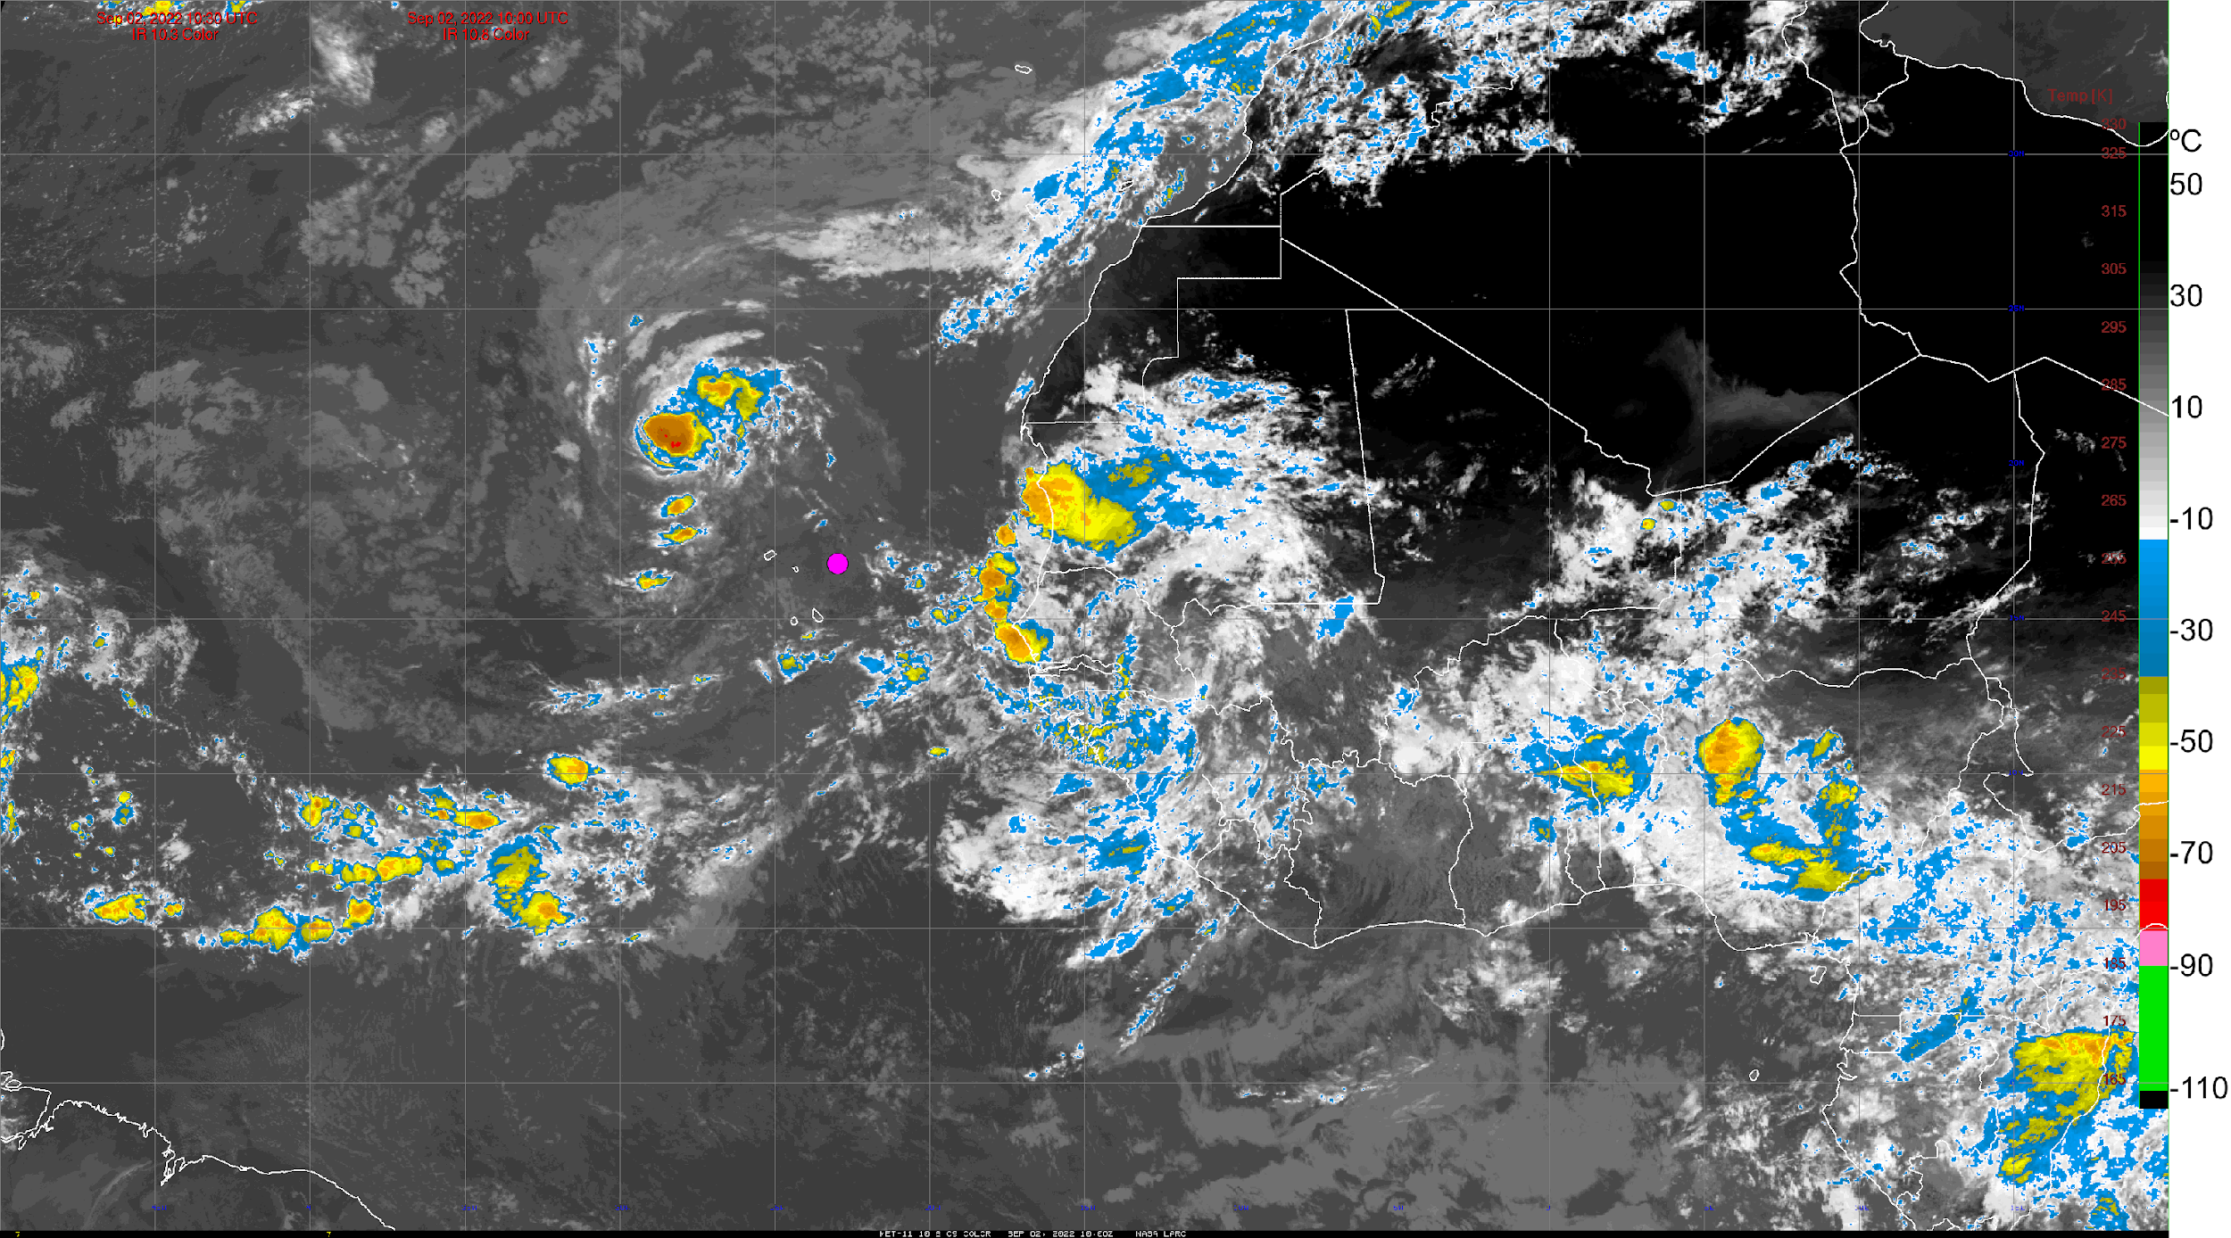
Current Conditions – AEWs, SAL, Satellite IR
Total Precipitable Water (XXZ) – MIMIC
IMERG Rain Rate, MSLP, AEWs (XXZ) – GFS
SAL (split window, XXZ) – GOES-16
GOES-16 / Meteosat-11 IR (XX:XXZ)

Slide 5
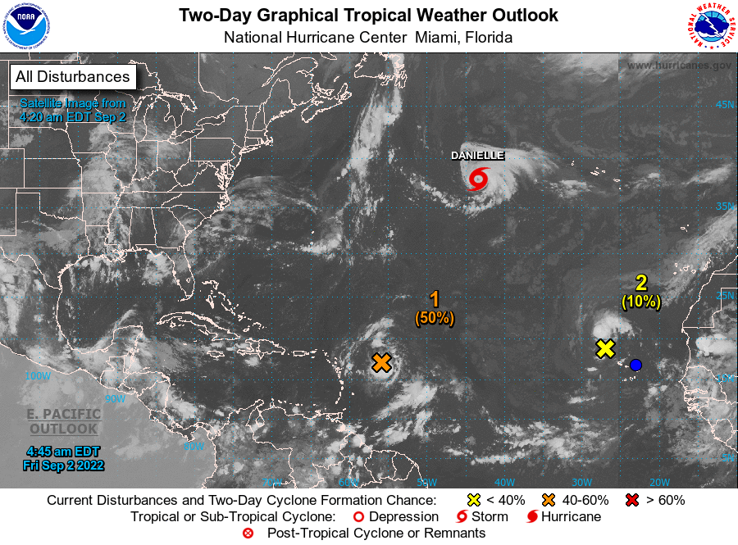
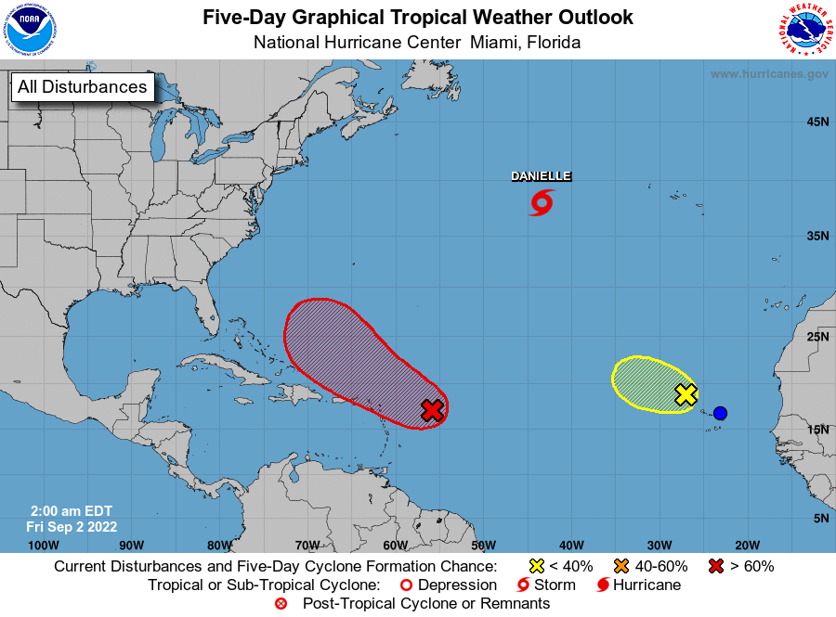
NHC Tropical Atlantic Outlook
(Sept. 3 & Sept. 6, 2022)
2-day Outlook
5-day Outlook
…

Slide 6
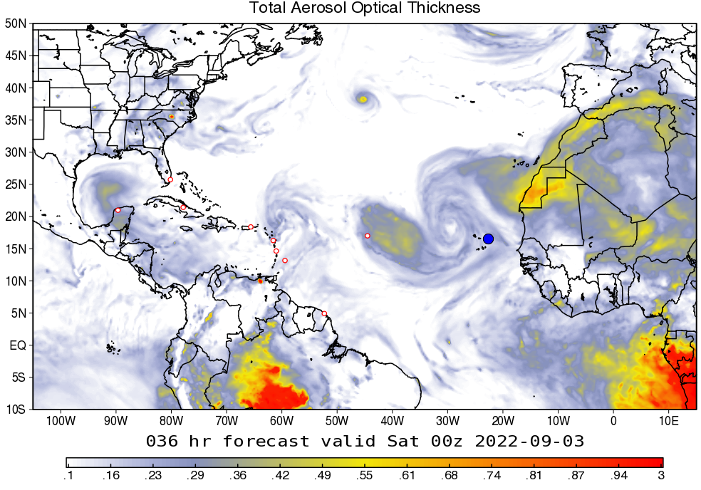
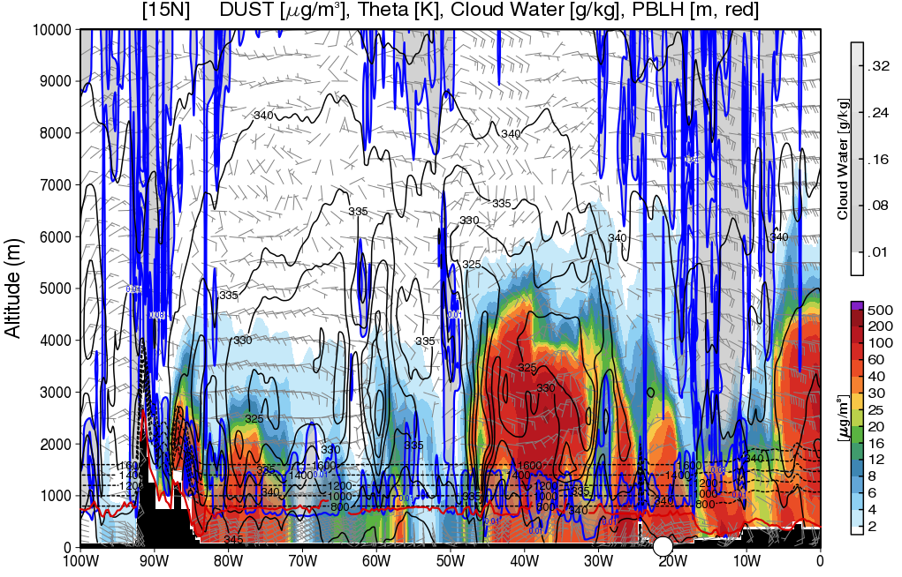
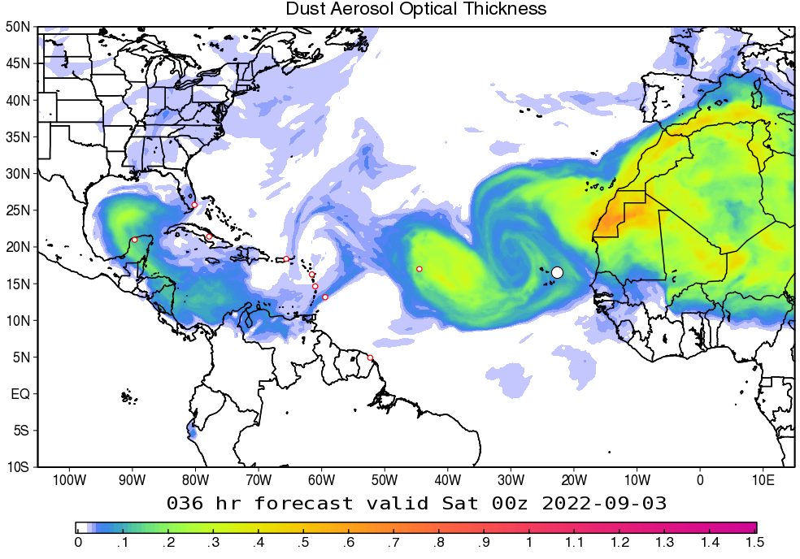
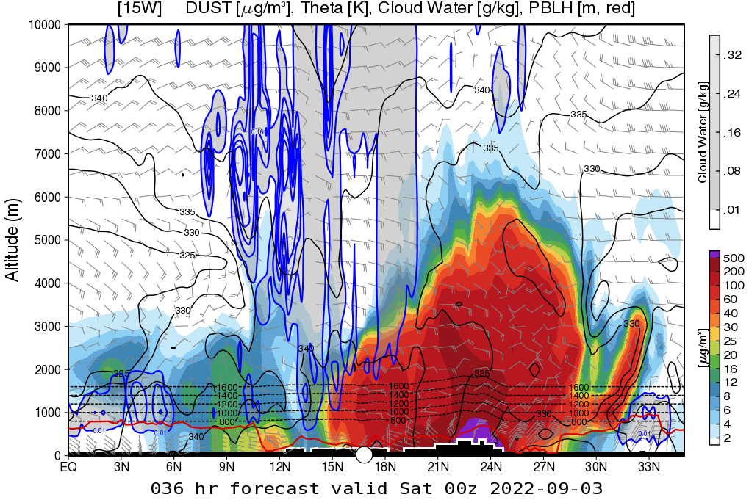
Dust and Aerosols – Day 1
(Sept. 2, 2022)
Total AOT – GEOS
Dust cross-section at 15°N
…
Dust AOT – GEOS
Dust cross-section at 20°W

Slide 7
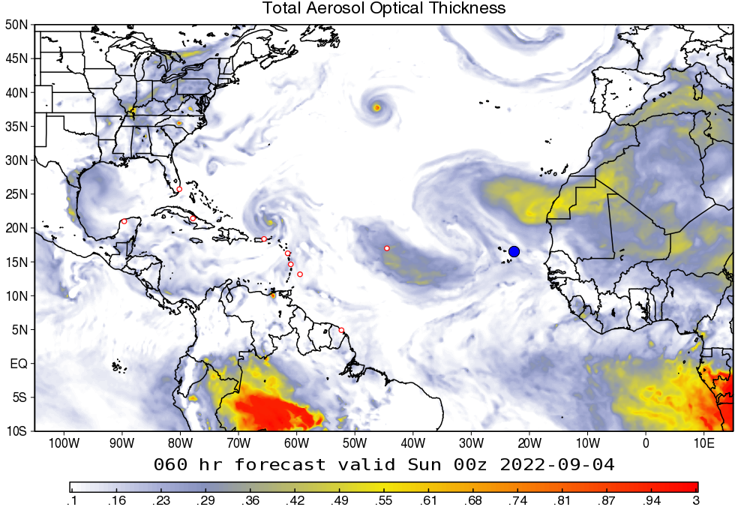
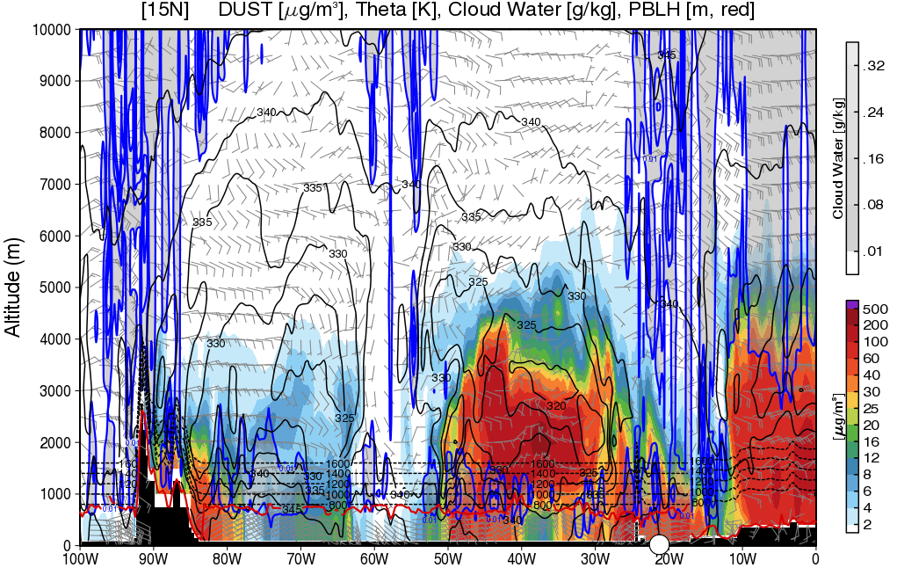
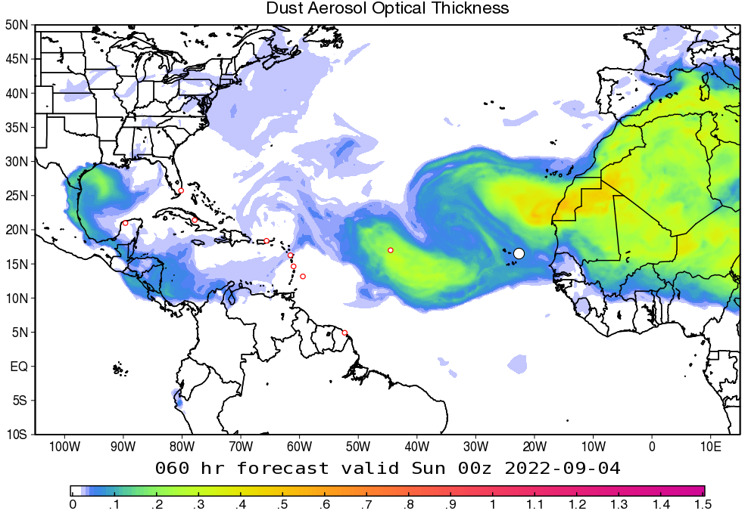
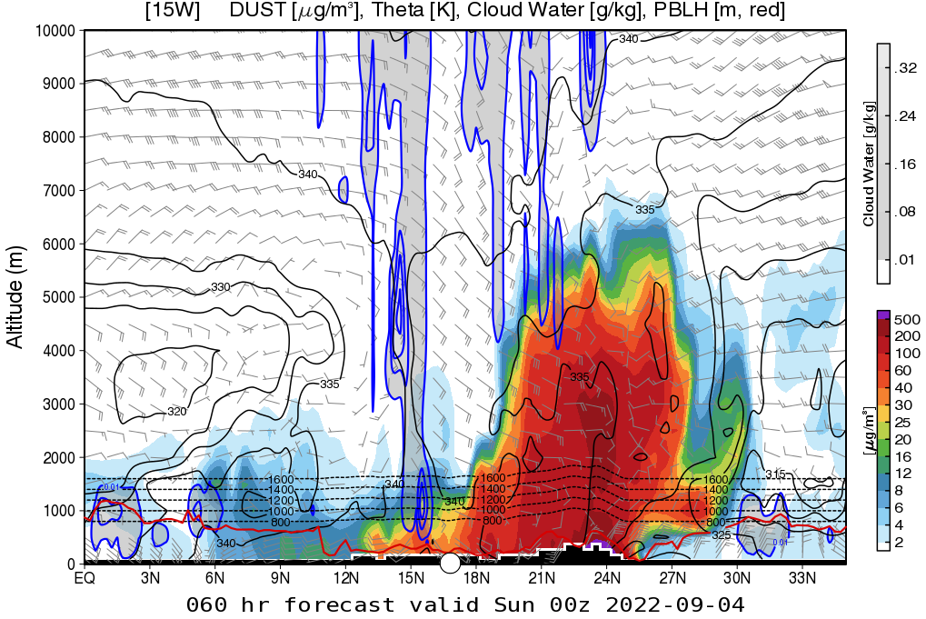
Dust and Aerosols – Day 2
(Sept. 3, 2022)
Total AOT – GEOS
Dust cross-section at 15°N
…
Dust AOT – GEOS
Dust cross-section at 20°W

Slide 8
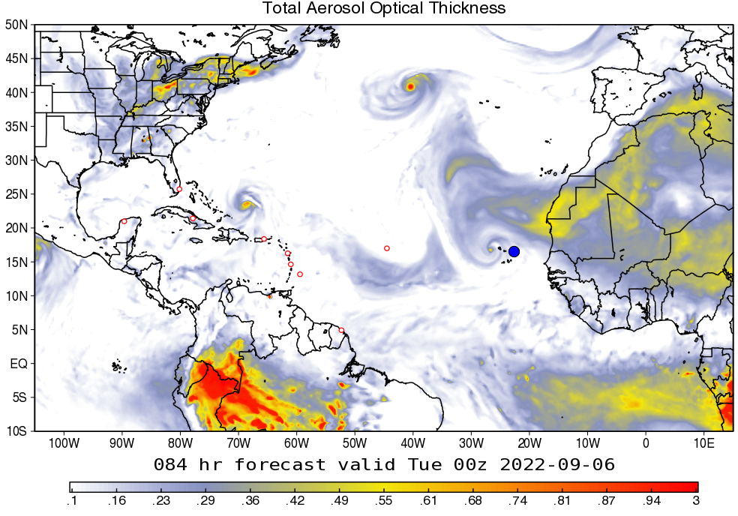
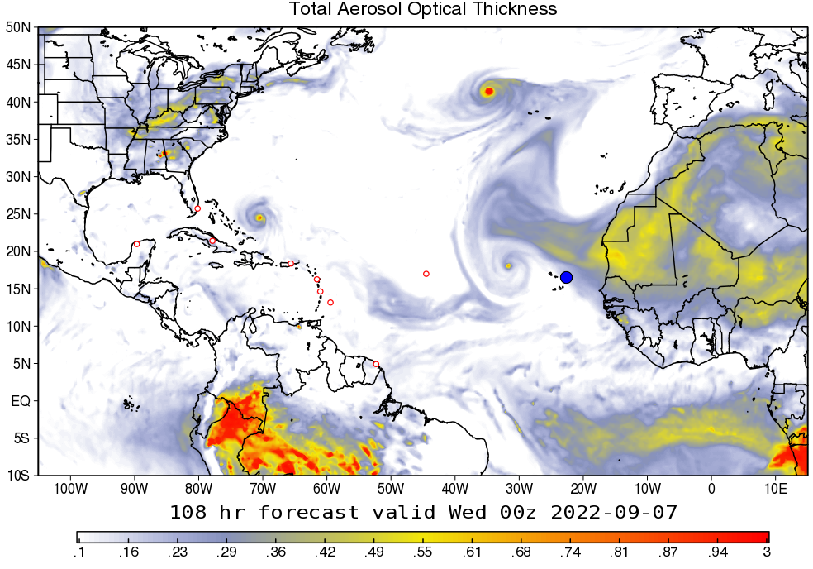
Dust and Aerosols – Days 3 & 4
(Sept. 4 & 5, 2022)
Ensemble Mean Total AOT – GEOS (day 3)
Ensemble Mean Total AOT – GEOS (day 4)
…

Slide 9
Dust and Aerosols – Forecast Tendency
Day 1 (Sept. XX):
Day 2 (Sept. XX):
Days 3-5 (Sept. XX – XX):

Slide 10
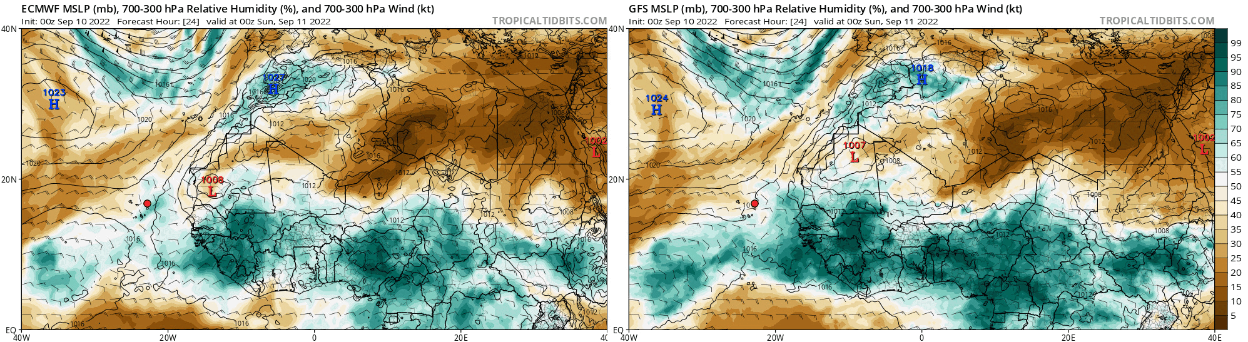
Forecast – AEWs (day 1)
(Sept. 2, 2022)
MSLP, 700-300mb RH, and 700-300mb Winds – ECMWF
MSLP, 700-300mb RH, and 700-300mb Winds – GFS
…

Slide 11
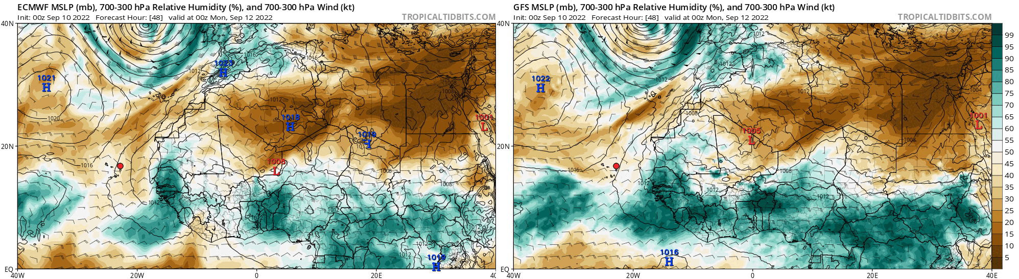
Forecast – AEWs (day 2)
(Sept. 3, 2022)
MSLP, 700-300mb RH, and 700-300mb Winds – ECMWF
MSLP, 700-300mb RH, and 700-300mb Winds – GFS
…

Slide 12
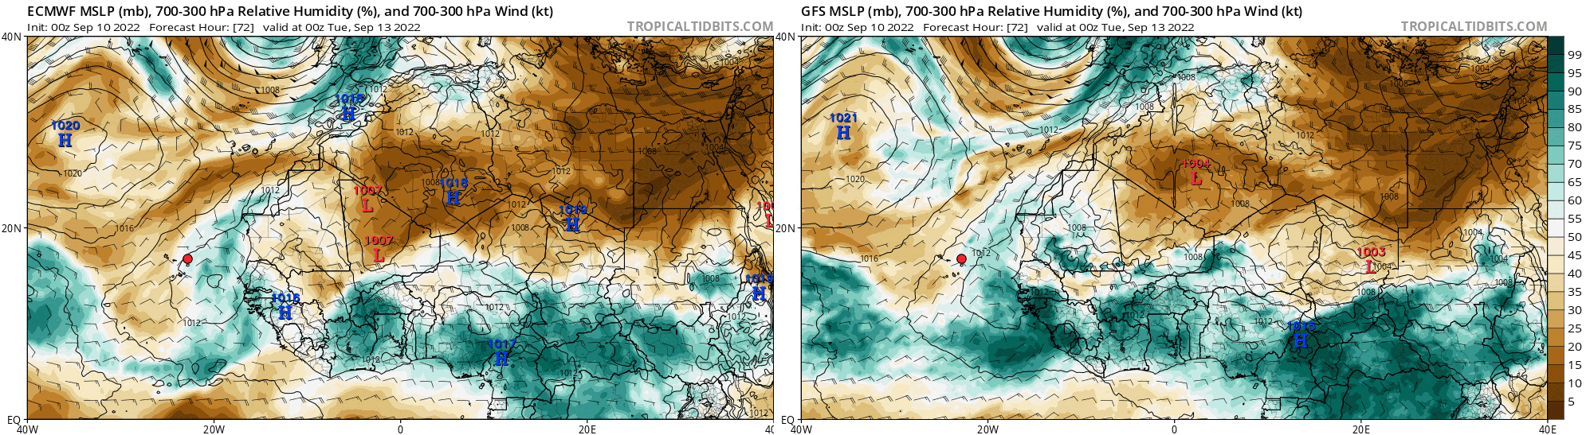
Forecast – AEWs (days 3-5)
(Sept. 4 – Sept. 6, 2022)
MSLP, 700-300mb RH, and 700-300mb Winds – ECMWF
MSLP, 700-300mb RH, and 700-300mb Winds – GFS
…

Slide 13
AEWs – Forecast Tendency
Day 1 (Sept. XX):
Day 2 (Sept. XX):
Days 3-5 (Sept. XX – XX):

Slide 14
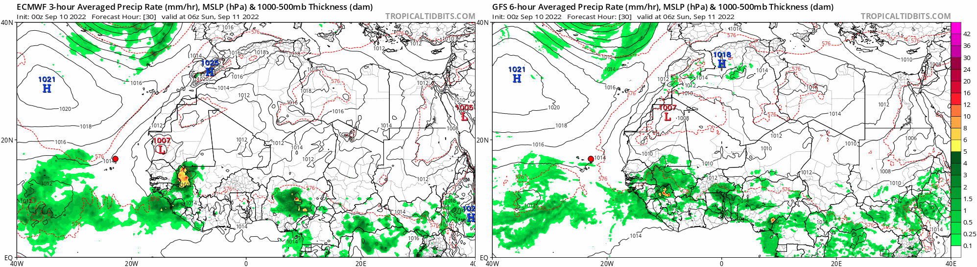
Forecast – Convection (day 1)
(Sept. 2, 2022)
MSLP, Rain Rate, 1000-500mb Thickness – ECMWF
MSLP, Rain Rate, 1000-500mb Thickness – GFS
…

Slide 15
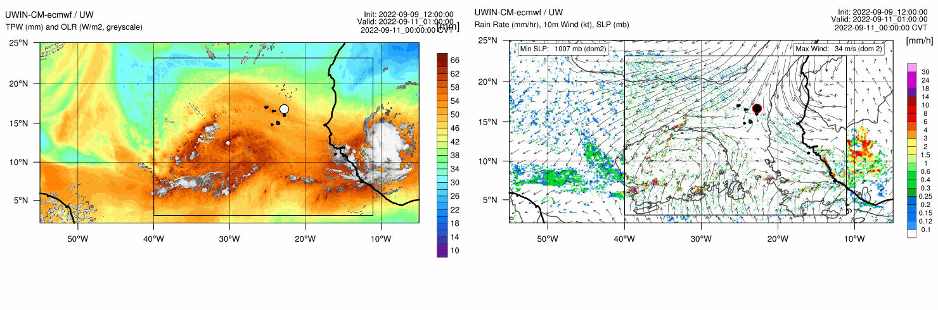
Forecast – Convection (day 1)
(Sept. 2, 2022)
TPW, OLR – UWIN-CM
10m Winds, MSLP, Rain – UWIN-CM
…

Slide 16
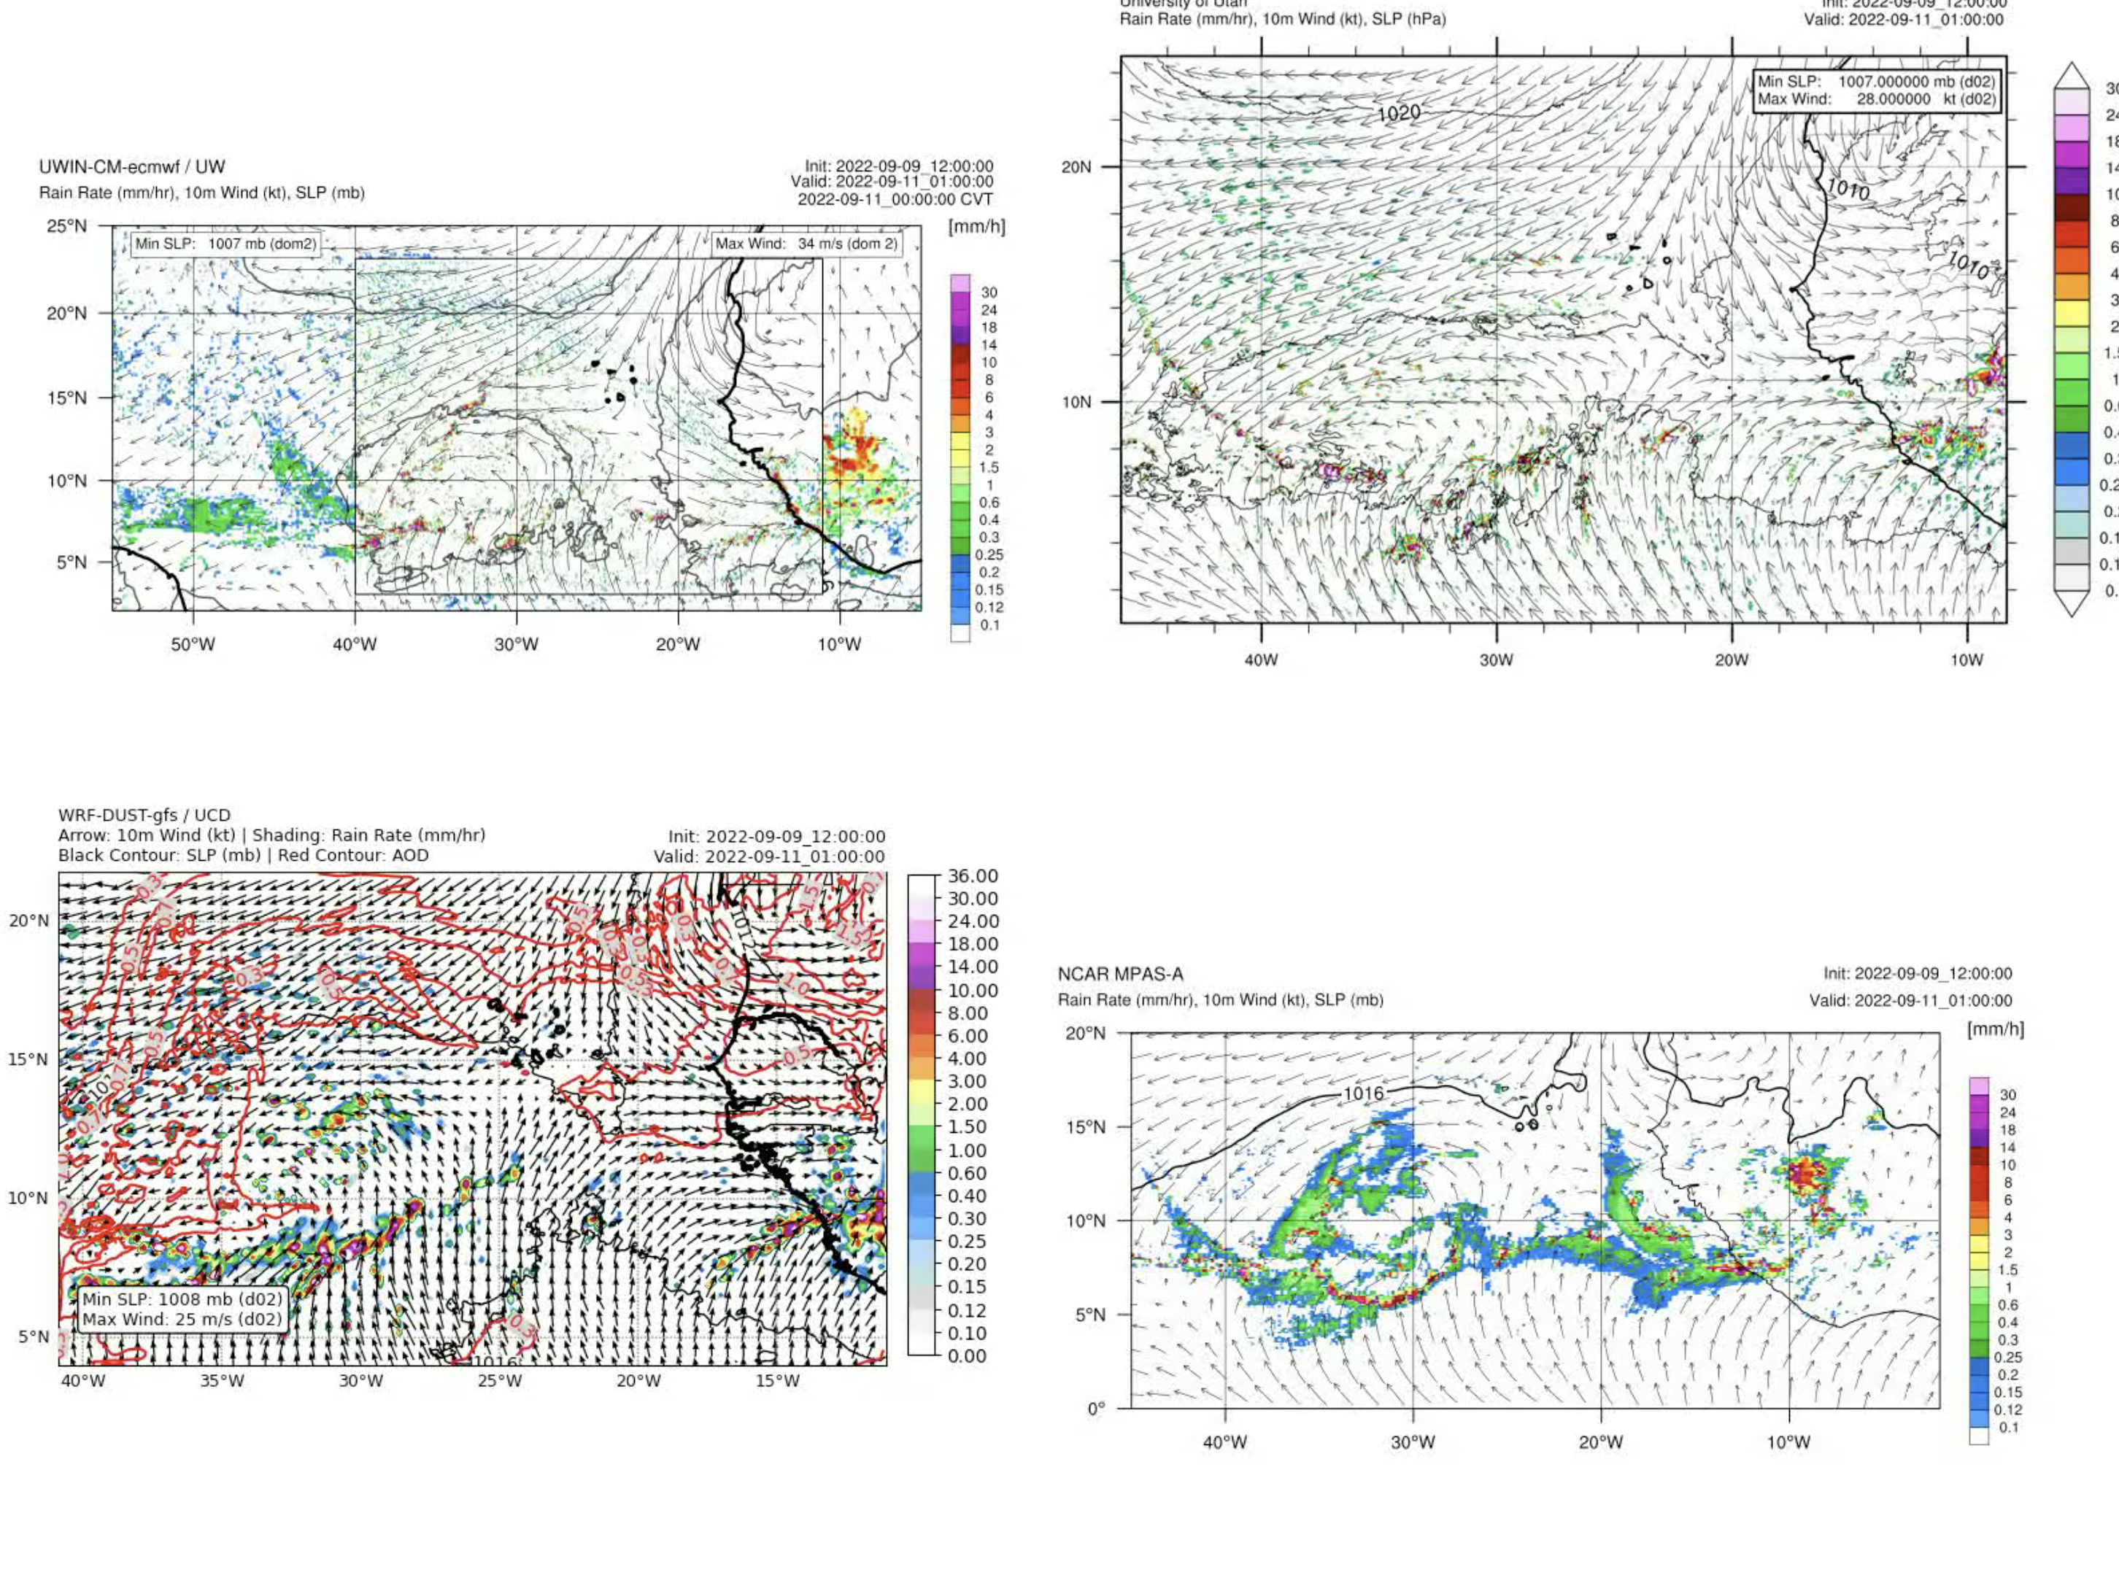
Forecast – Convection (day 1)
(Sept. 2, 2022)
…

Slide 17
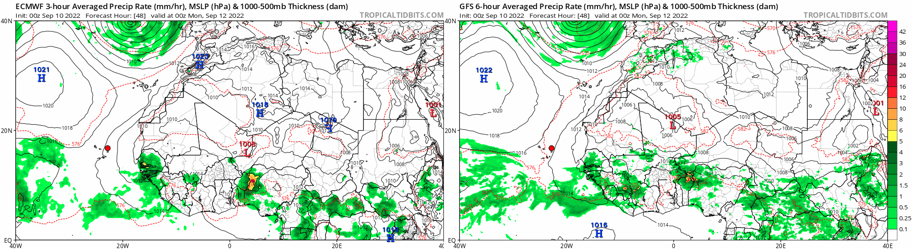
Forecast – Convection (day 2)
(Sept. 3, 2022)
MSLP, Rain Rate, 1000-500mb Thickness – ECMWF
MSLP, Rain Rate, 1000-500mb Thickness – GFS
…

Slide 18
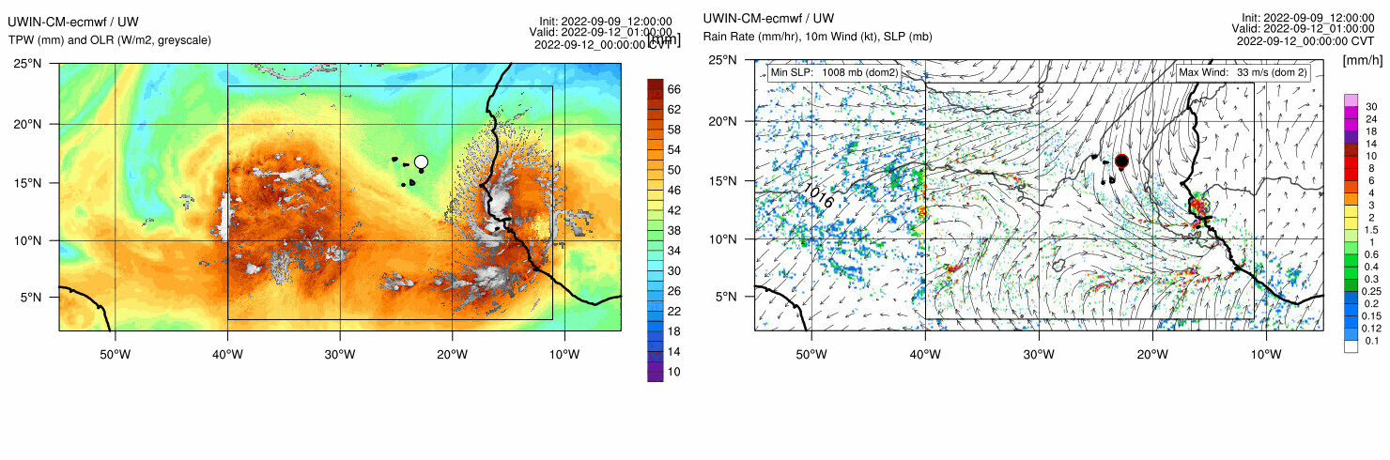
Forecast – Convection (day 2)
(Sept. 3, 2022)
TPW, OLR – UWIN-CM
10m Winds, MSLP, Rain – UWIN-CM
…

Slide 19
Forecast – Convection (day 2)
(Sept. 3, 2022)
…

Slide 20
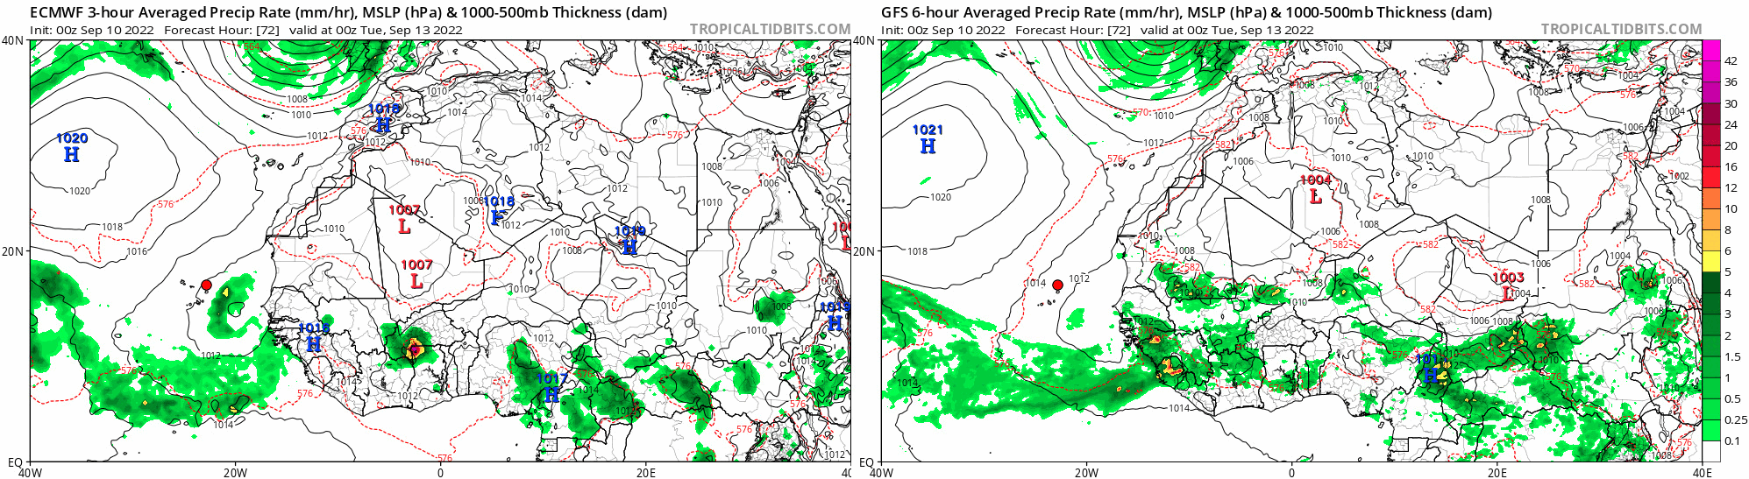
Forecast – Convection (days 3-5)
(Sept. 4 – Sept. 6, 2022)
MSLP, Rain Rate, 1000-500mb Thickness – ECMWF
MSLP, Rain Rate, 1000-500mb Thickness – GFS
…

Slide 21
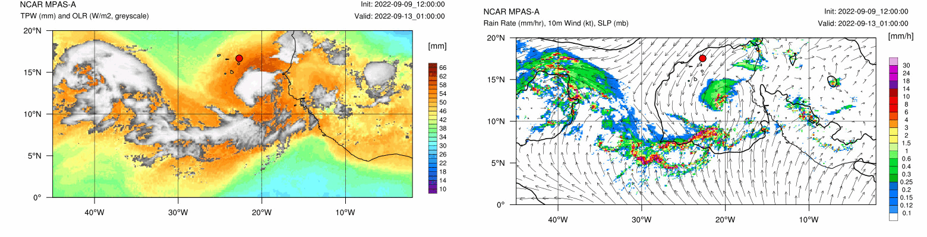
Forecast – Convection (days 3-4)
(Sept. 4 & 5, 2022)
TPW, OLR – MPAS
10m Winds, Hourly Rain Rate – MPAS
…

Slide 22
Convection – Forecast Tendency
Day 1 (Sept. XX):
Day 2 (Sept. XX):
Days 3-5 (Sept. XX – XX):

Slide 23
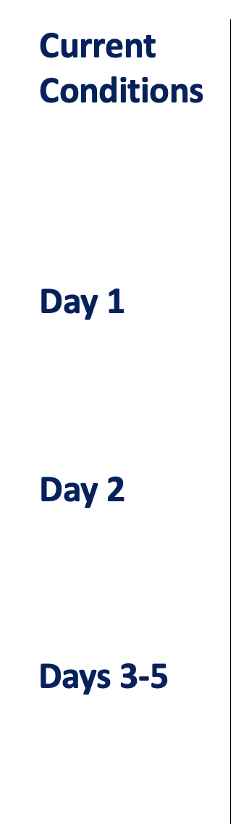
Summary
XXX.
XXX.
XXX.
XXX.

